Slide 1
LSTM on Pollution Data
Team 6
Hackathon July 19, 2018

Slide 2
LSTM = Long Short Term Memory
What is LSTM?
“Long short-term memory (LSTM) units (or blocks) are a building unit for layers of a recurrent neural network (RNN)” (Wikipedia July 2018)
-RNN= Recurrent Neural Network
-Recurrent Neural Network is “class of artificial neural network where connections between units form a directed graph along a sequence” (Shekhar April 2018)

Slide 3
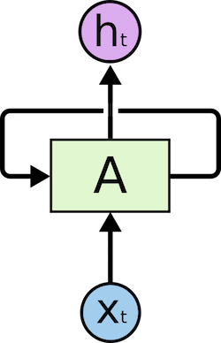
Recurrent Neural Network-RNN
“RNN remembers everything” (Shekhar April 2018)
“RNN creates the networks with loops in them, which allows it to persist the information”
h is output
x is input

Slide 4
Problem Statement:
How to improve the accuracy in pollution data?
How?
Inputs, and Outputs
Understanding RNN
Architecture, and Structure
Changing Parameters (add layers, different initial values, epoch, or batch size)

Slide 5
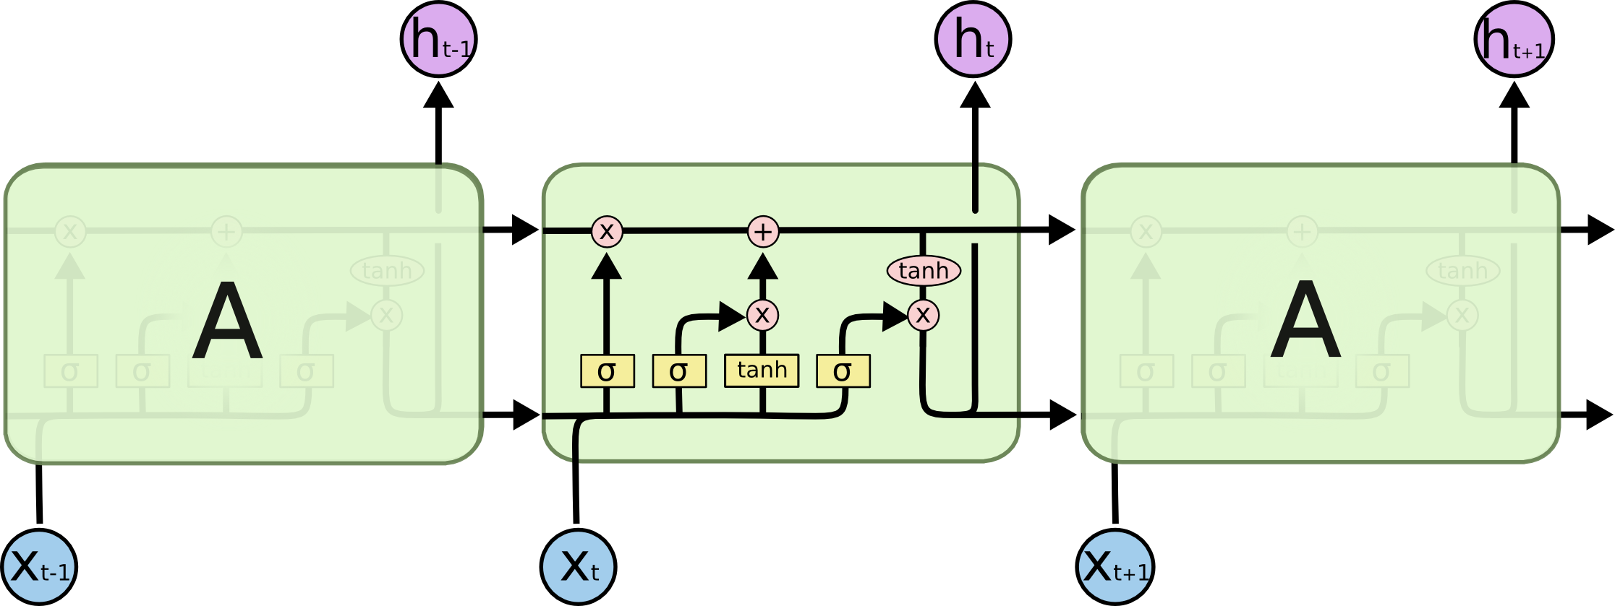
How?
Architecture, and Structure of Neural Networks:
A= layer and output layer is h. Arrows show flow of data.
Changing Parameters (add layers, different initial values, epoch, or batch size)

Slide 6
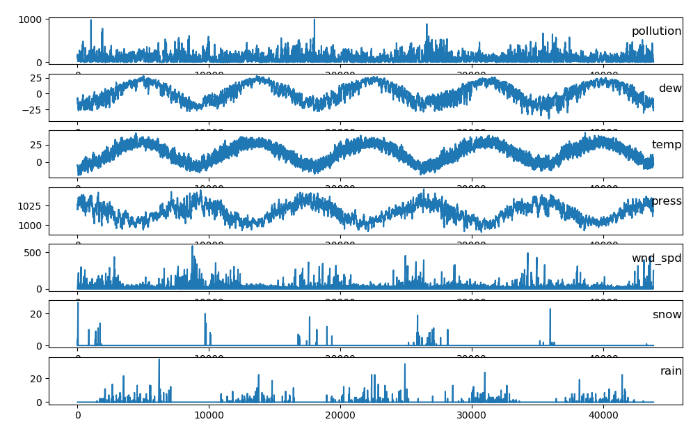

Slide 7
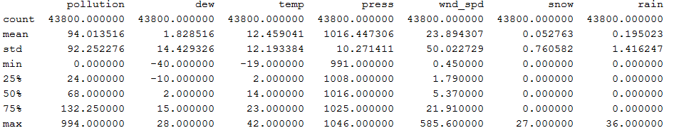

Slide 8
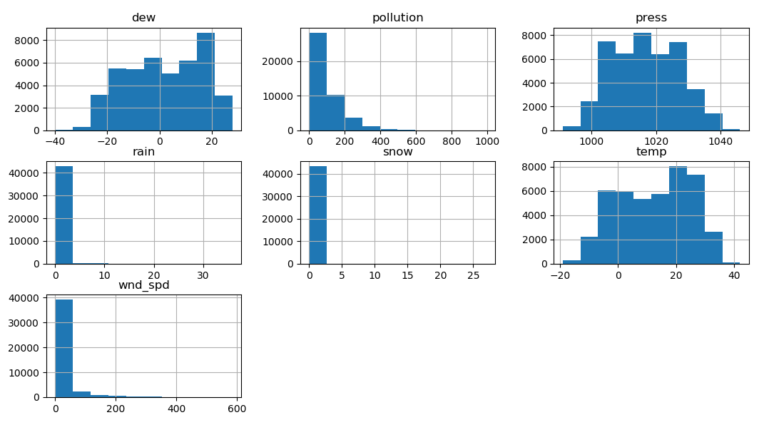

Slide 9
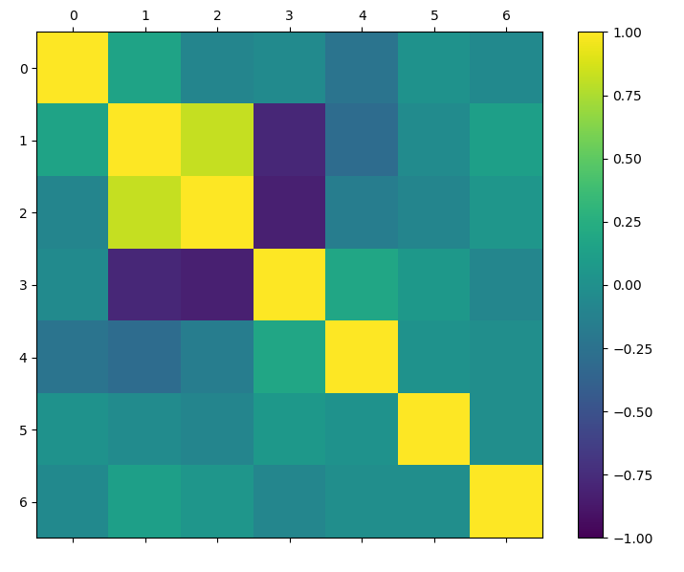

Slide 10
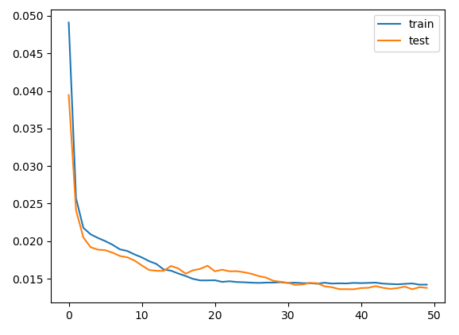
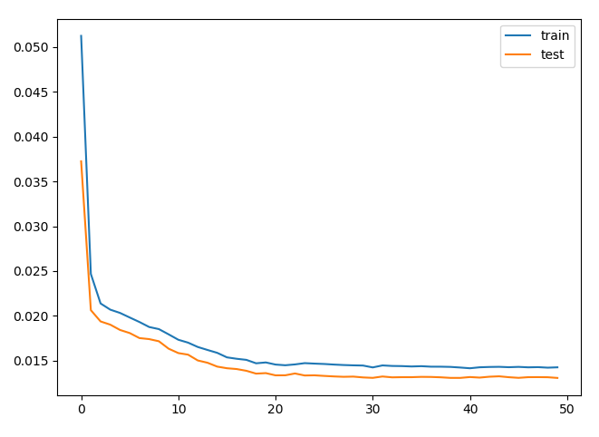
Epoch 50/50 - 1s - loss: 0.0142 - val_loss: 0.0138
Epoch 50/50 - 1s - loss: 0.0143 - val_loss: 0.0131
Epoch=50, batch_size=72, hidden layer=1

Slide 11
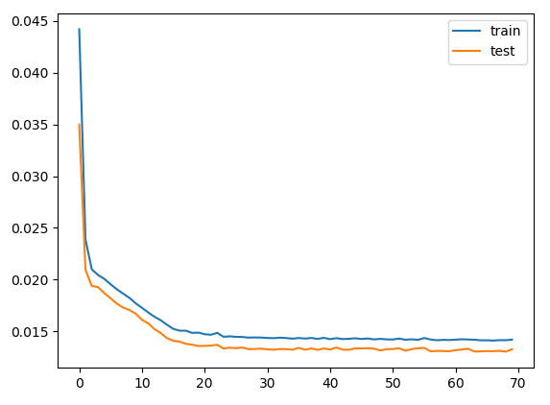
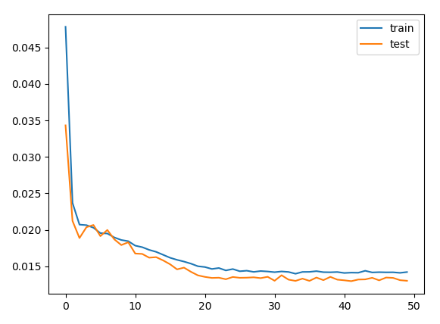
Epoch 70/70, batch size =72
- 1s - loss: 0.0142 - val_loss: 0.0133
Epoch 50/50, batch size = 100
- 1s - loss: 0.0142 - val_loss: 0.0130

Slide 12
Sources
Shekhar, Amit (April 2018) Medium: Mindorks: Understanding The Recurrent Neural Network https://medium.com/mindorks/understanding-the-recurrent-neural-network-44d593f112a2
Wikipedia: Long-short term Memory (July 3, 2018) https://en.wikipedia.org/wiki/Long_short-term_memory

